Slide 1
SpecAugment: A Simple Data Augmentation Method for Automatic Speech Recognition
SpecAugment: A Simple Data Augmentation Method for Automatic Speech Recognition

Slide 2
TABLE OF CONTENTS
01
02
03
04
Introduction
SpecAugment Methods
Paper's Experimental Setup
Our Experimental Setup

Slide 3

0
Introduction
1
1

Slide 4
Challenges in ASR and Limitations of Existing Augmentation
Existing Data Augmentation Approaches
Challenges in Deep Learning ASR
Modern ASR systems (e.g., LAS) perform well but are prone to overfitting, especially with limited training data.
Additional Data Requirements: Methods require additional data sources
Computational Complexity: Operating on raw audio is computationally expensive

Slide 5
Motivation Behind SpecAugment
Motivation for a New Approach
What SpecAugment proposes
SpecAugment introduces three direct transformations on log mel spectrogram:
Time Warping
Frequency Masking
Time Masking
From the limitations, arises the need for:
A simple, low-cost method
That works without additional data
And can be applied directly on features (not raw audio)

Slide 6
0
Introduction
2
1

Slide 7

0
SpecAugment Methods
2

Slide 8
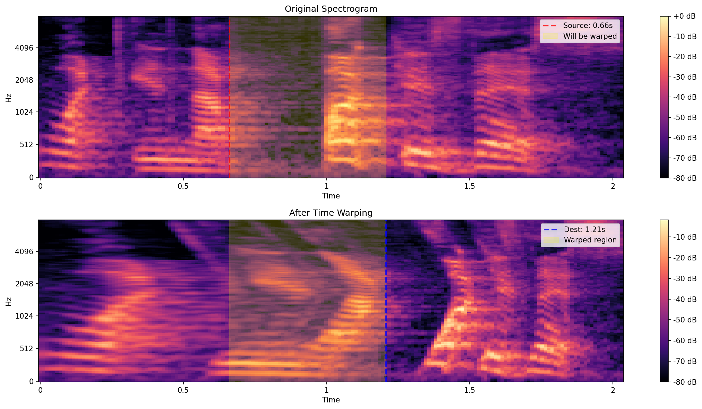
Time Warping
Applies sparse_image_warp from TensorFlow
Treats log-mel spectrogram as an image (time = horizontal, freq = vertical)
Random point along center horizontal line is warped left/right by ≤ W
6 boundary points (corners + vertical midpoints) are fixed to keep shape stable

Slide 9
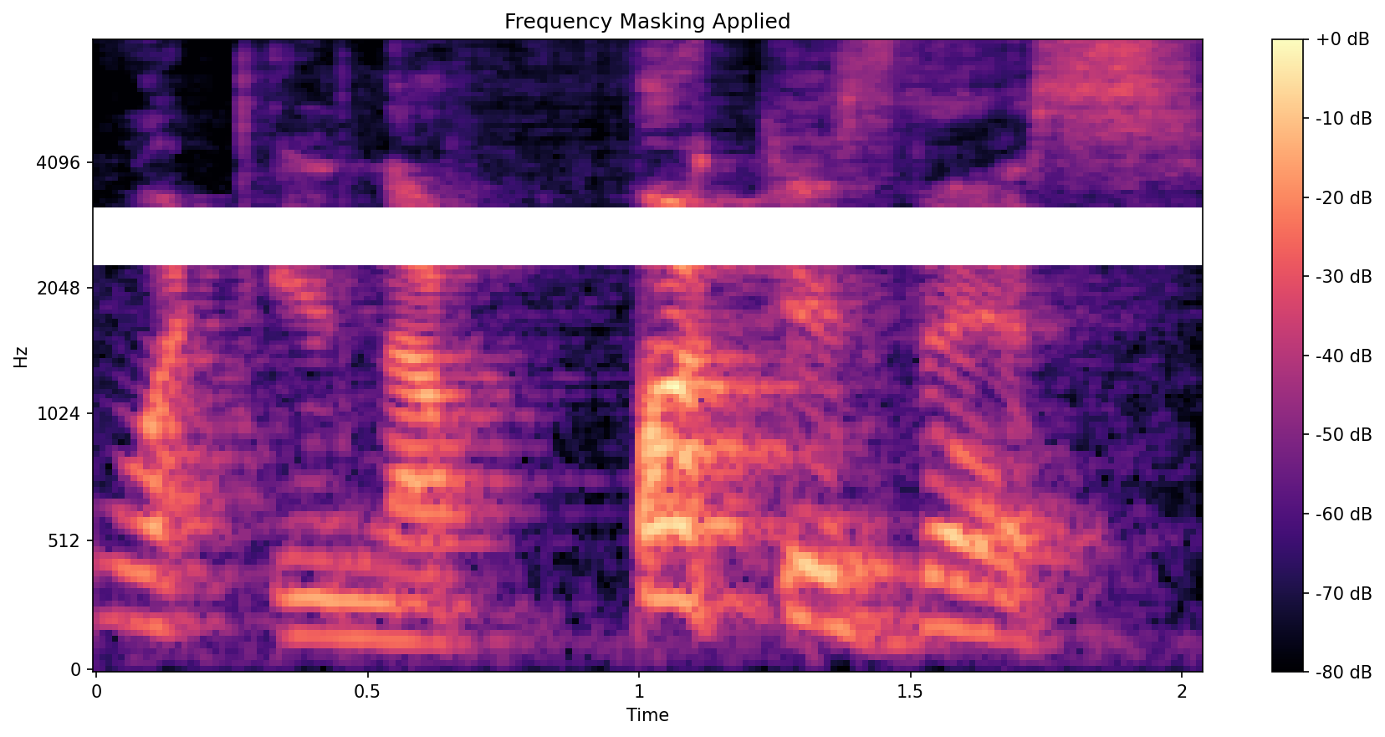
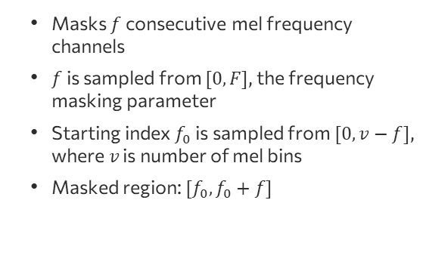
Frequency Masking
Masks $f$consecutive mel frequency channels
$f$ is sampled from $[0,F]$, the frequency masking parameter
Starting index $f_{0}$ is sampled from $[0,v−f]$, where $v$ is number of mel bins
Masked region: $[f_{0},f_{0}+f]$

Slide 10
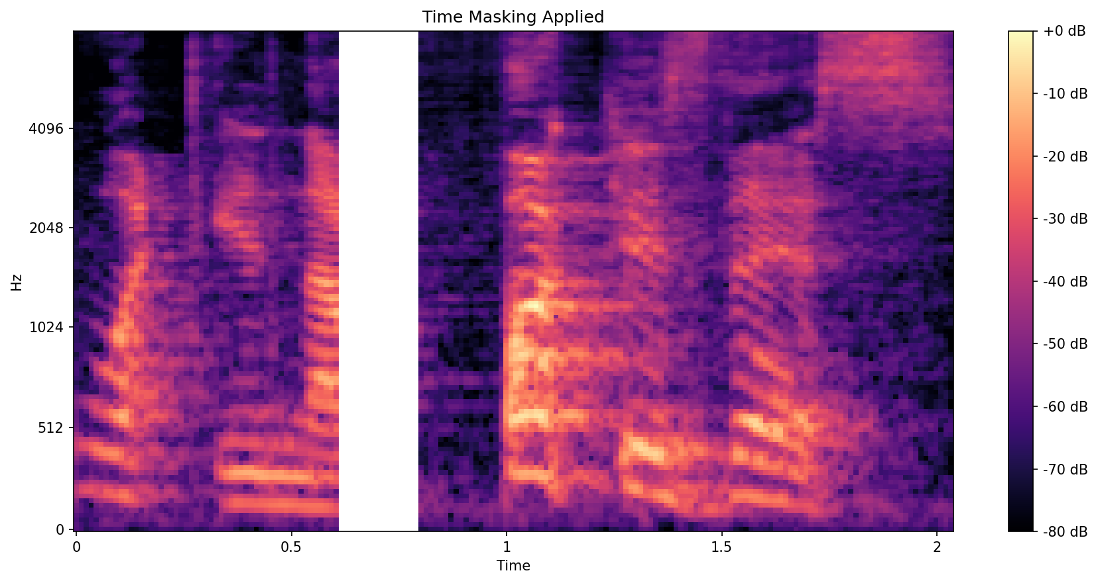
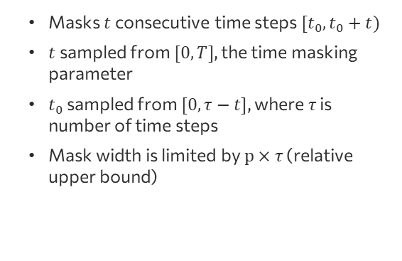
Time Masking
Masks $t$ consecutive time steps $[t_{0}, t_{0}+t)$
$t$ sampled from $[0, T]$, the time masking parameter
$t_{0}$ sampled from $[0, τ−t]$, where $τ$ is number of time steps
Mask width is limited by $p×τ$ (relative upper bound)

Slide 11
0
SpecAugment Methods
3
2

Slide 12

0
Paper's Experimental Setup
3

Slide 13
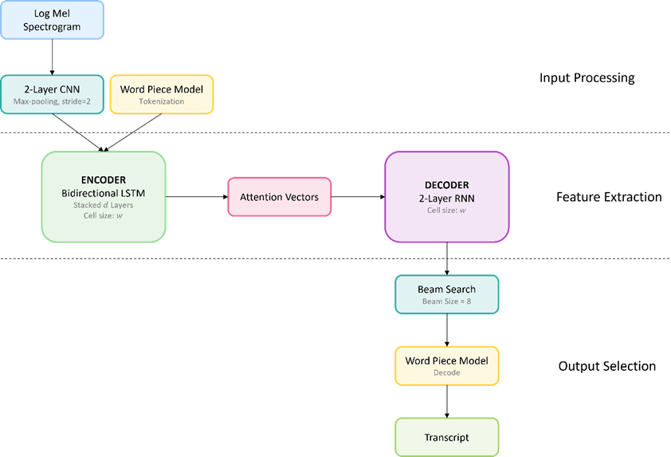
LAS Network Architectur
Input: log mel spectrogram → 2-layer CNN with stride 2 for feature extraction.
Word Piece Model (WPM) is applied right after input for tokenization.

Slide 14
LAS Network Architectur
CNN output is fed into encoder consisting of d stacked bi-directional LSTM layers (cell size w).
Encoder generates attention vectors.
Attention vectors are passed to 2-layer RNN decoder (cell size w)

Slide 15
LAS Network Architectur
Uses Word Piece Model (WPM): 16k vocab for LibriSpeech, 1k for Switchboard.
WPM built from training transcripts (LibriSpeech + Fisher).
Token-level prediction using Beam Search (beam size = 8).

Slide 16
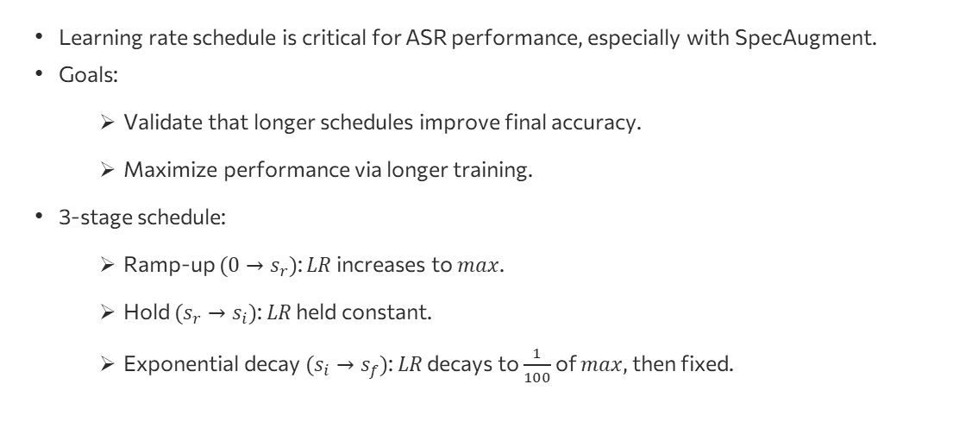
Learning Rate Schedules
Learning rate schedule is critical for ASR performance, especially with SpecAugment.
Goals:
Validate that longer schedules improve final accuracy.
Maximize performance via longer training.
3-stage schedule:
Ramp-up $(0→s_{r})$: $LR$ increases to $max$.
Hold $(s_{r}→s_{i})$: $LR$ held constant.
Exponential decay $(s_{i}→s_{f})$: $LR$ decays to $\frac{1}{100}$ of $max$, then fixed.

Slide 17
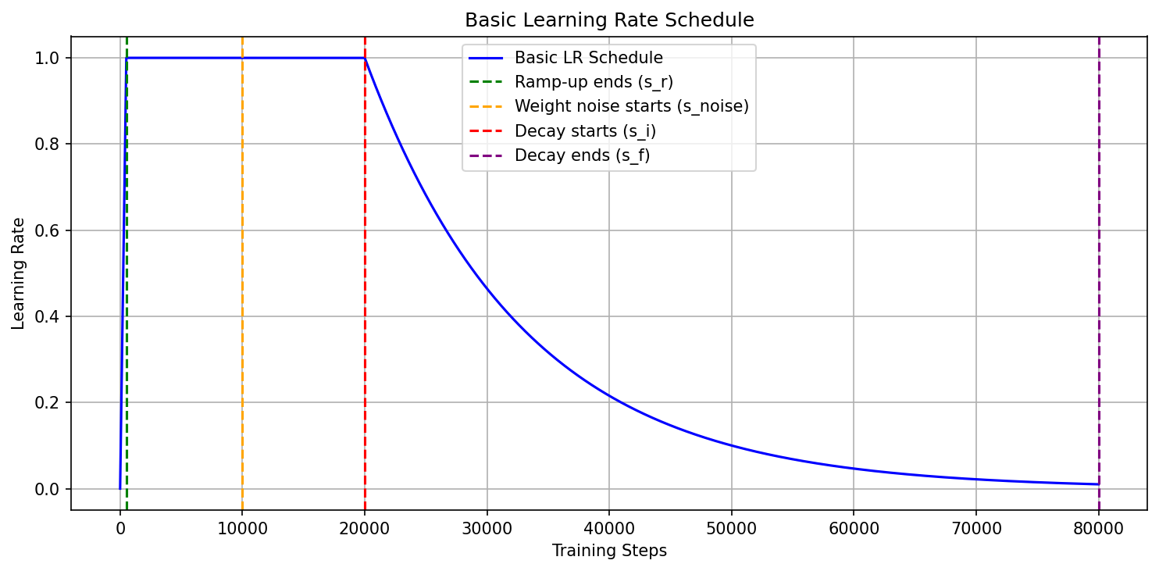
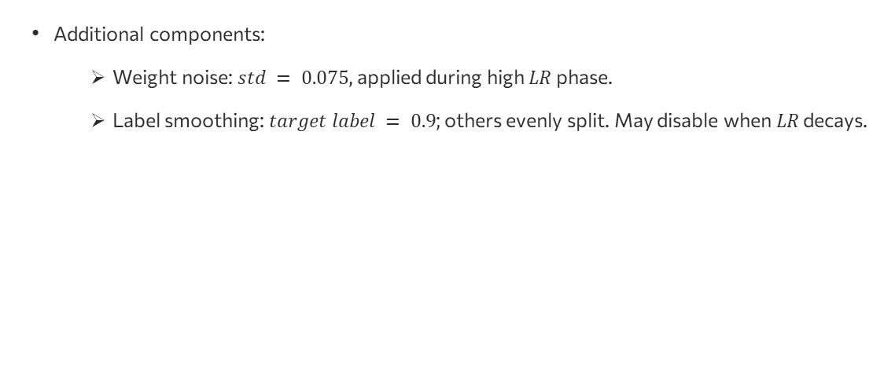
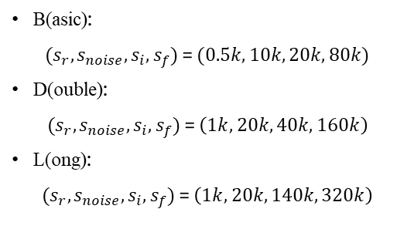
Learning Rate Schedules
Additional components:
Weight noise: $std = 0.075$, applied during high $LR$ phase.
Label smoothing: $target label = 0.9$; others evenly split. May disable when $LR$ decays.
B(asic):
$(s_{r}, s_{noise}, s_{i},s_{f})$ = $(0.5k, 10k, 20k, 80k)$
D(ouble):
$(s_{r}, s_{noise}, s_{i},s_{f})$ = $\left(1k, 20k, 40k, 160k\right)$
L(ong):
$(s_{r}, s_{noise}, s_{i},s_{f})$ = $\left(1k, 20k, 140k, 320k\right)$

Slide 18

Learning Rate Schedules
Additional components:
Weight noise: $std = 0.075$, applied during high $LR$ phase.
Label smoothing: $target label = 0.9$; others evenly split. May disable when $LR$ decays.
B(asic):
$(s_{r}, s_{noise}, s_{i},s_{f})$ = $(0.5k, 10k, 20k, 80k)$
D(ouble):
$(s_{r}, s_{noise}, s_{i},s_{f})$ = $\left(1k, 20k, 40k, 160k\right)$
L(ong):
$(s_{r}, s_{noise}, s_{i},s_{f})$ = $\left(1k, 20k, 140k, 320k\right)$

Slide 19
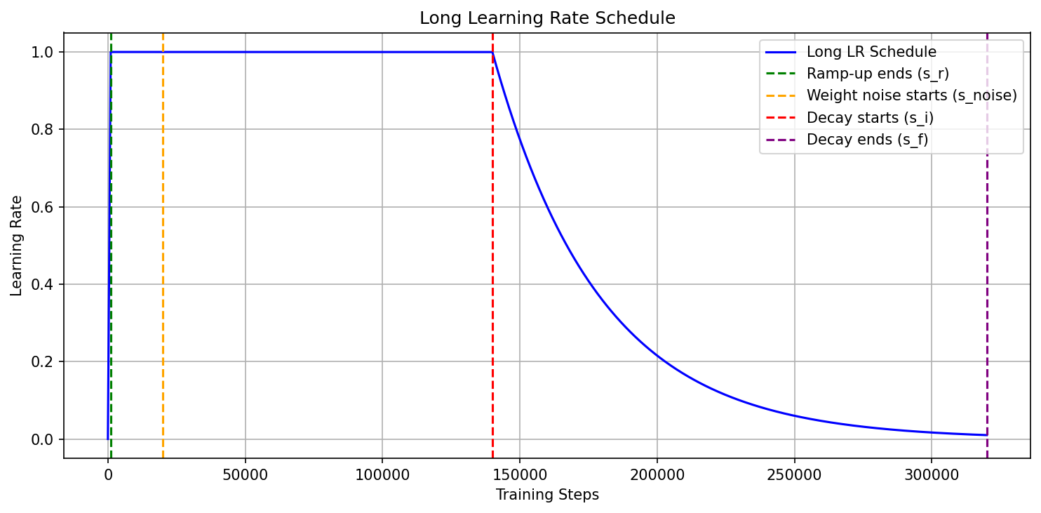
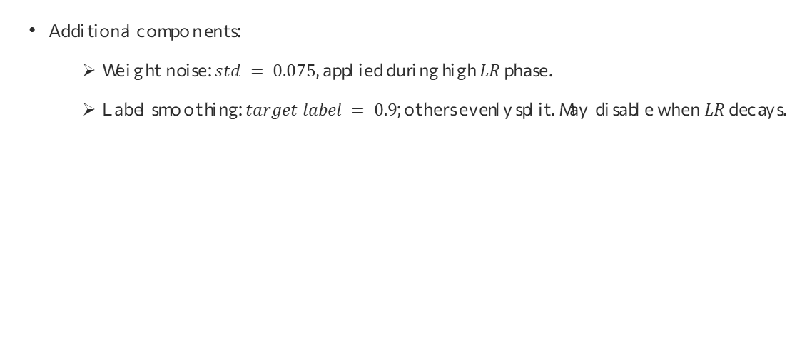
Learning Rate Schedules
Additional components:
Weight noise: $std = 0.075$, applied during high $LR$ phase.
Label smoothing: $target label = 0.9$; others evenly split. May disable when $LR$ decays.
B(asic):
$(s_{r}, s_{noise}, s_{i},s_{f})$ = $(0.5k, 10k, 20k, 80k)$
D(ouble):
$(s_{r}, s_{noise}, s_{i},s_{f})$ = $\left(1k, 20k, 40k, 160k\right)$
L(ong):
$(s_{r}, s_{noise}, s_{i},s_{f})$ = $\left(1k, 20k, 140k, 320k\right)$

Slide 20
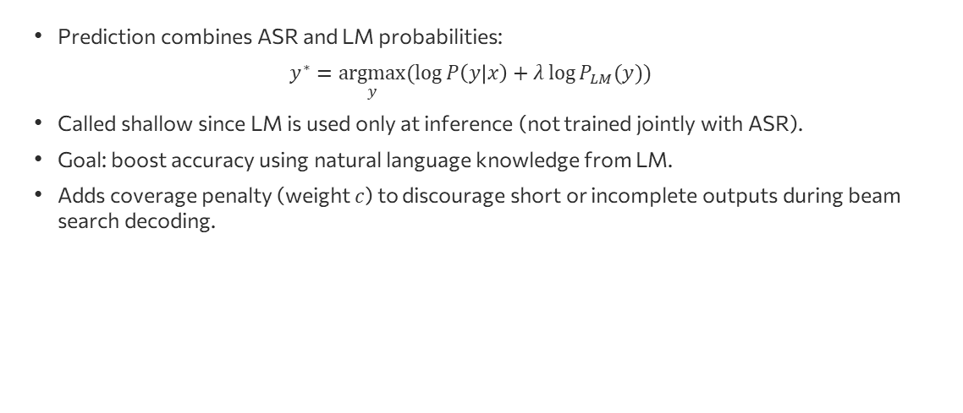
Shallow Fusion with Language Models
Prediction combines ASR and LM probabilities:
$$y^{∗}=\underset{y}{argmax}{(\log{P\left(y | x\right)+λ\log{P_{LM}(y)}})}$$
Called shallow since LM is used only at inference (not trained jointly with ASR).
Goal: boost accuracy using natural language knowledge from LM.
Adds coverage penalty (weight $c$) to discourage short or incomplete outputs during beam search decoding.

Slide 21
0
Paper's Experimental Setup
4
3

Slide 22

0
Our Experimental Setup
4

Slide 23
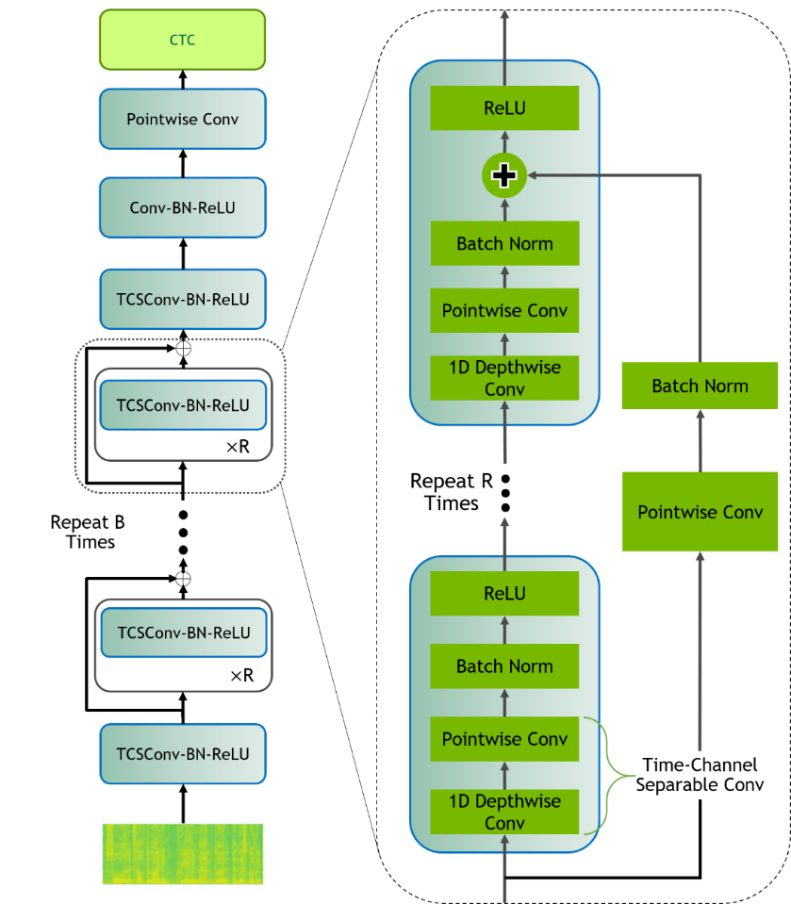
Model Architecture
QuartzNet 15x5 is a lightweight end-to-end ASR model using 1D time-channel separable convolutions (TCSConv) for efficiency.
Input: log mel spectrogram
Architecture:
Initial pointwise convolution to adjust channels
Followed by 15 blocks, each repeated 5 times, where each block contains:
1D depthwise convolution
Pointwise convolution
BatchNorm, ReLU, and residual connection
Output: Connected to a CTC layer for alignment-free sequence prediction

Slide 24
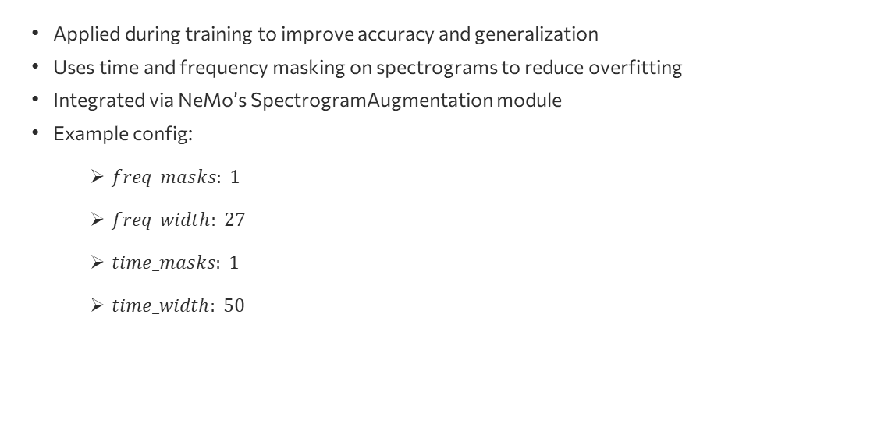
SpecAugment – Data Augmentation
Applied during training to improve accuracy and generalization
Uses time and frequency masking on spectrograms to reduce overfitting
Integrated via NeMo’s SpectrogramAugmentation module
Example config:
$freq_masks: 1$
$freq_width: 27$
$time_masks: 1$
$time_width: 50$

Slide 25
Datasets
Experiments were conducted on two datasets: LibriSpeech (English) and VIVOS (Vietnamese), as per guidance.
Due to limited resources (training on Kaggle GPU P100 with max 12h continuous training), only LibriSpeech clean-100 and VIVOS (15 hours) were used.
VIVOS small size highlights SpecAugment’s effectiveness.
Dataset | Train Speakers | Test Speakers | Train Utterances | Test Utterances | Train Duration (h) | Test Duration (h)
LibriSpeech | 251 | 40 | 28,539 | 2,620 | 100 | 5.4
VIVOS | 46 | 19 | 11,660 | 760 | 14.92 | 0.75
(Speakers: number of speakers, Utterances: number of transcripts (data samples), Duration: total audio length per set)

Slide 26
Results and Observations
LibreSpeech-100
VIVOS Corpus

Slide 27
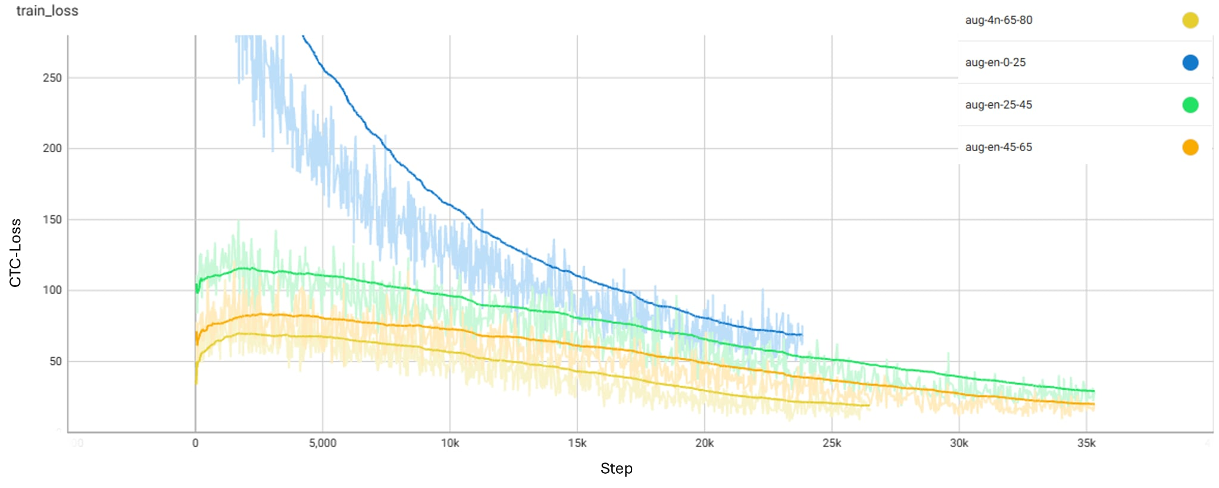
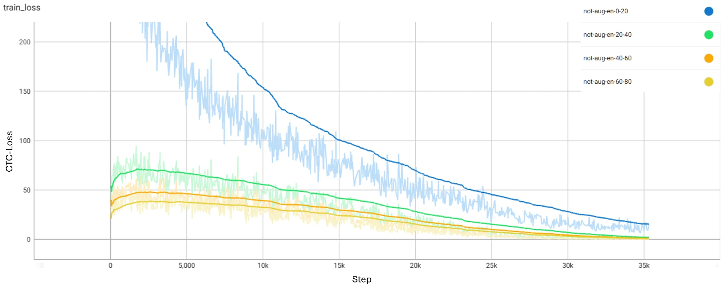
Results and Observations
LibreSpeech-100

Slide 28
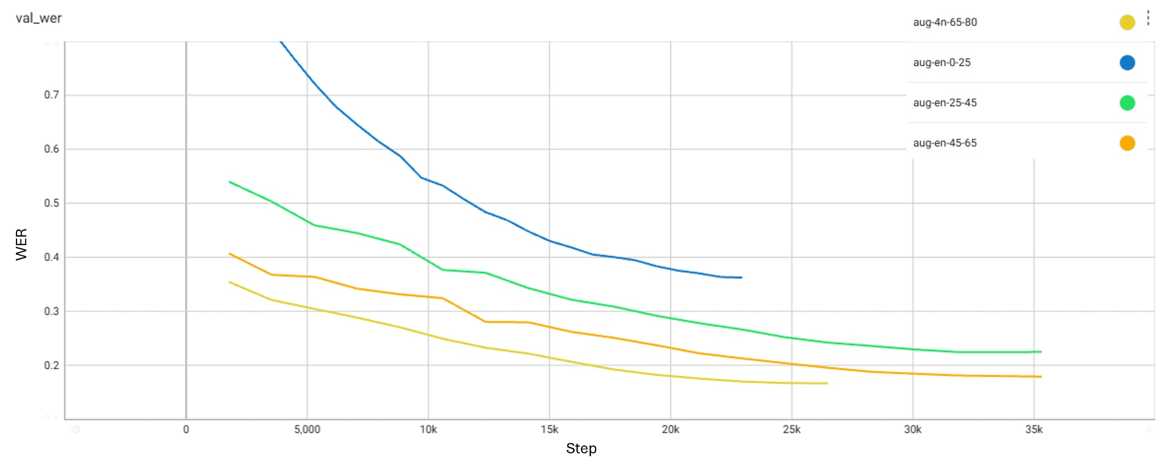
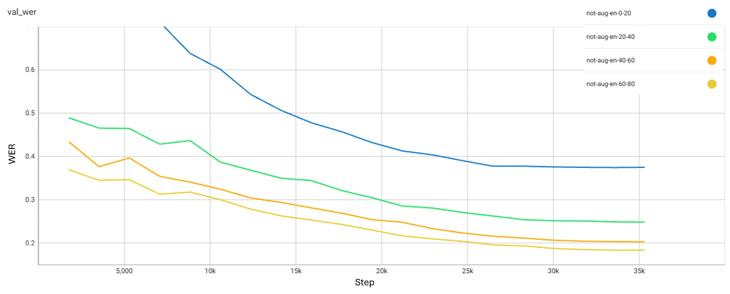
Results and Observations
LibreSpeech-100
VIVOS Corpus

Slide 29
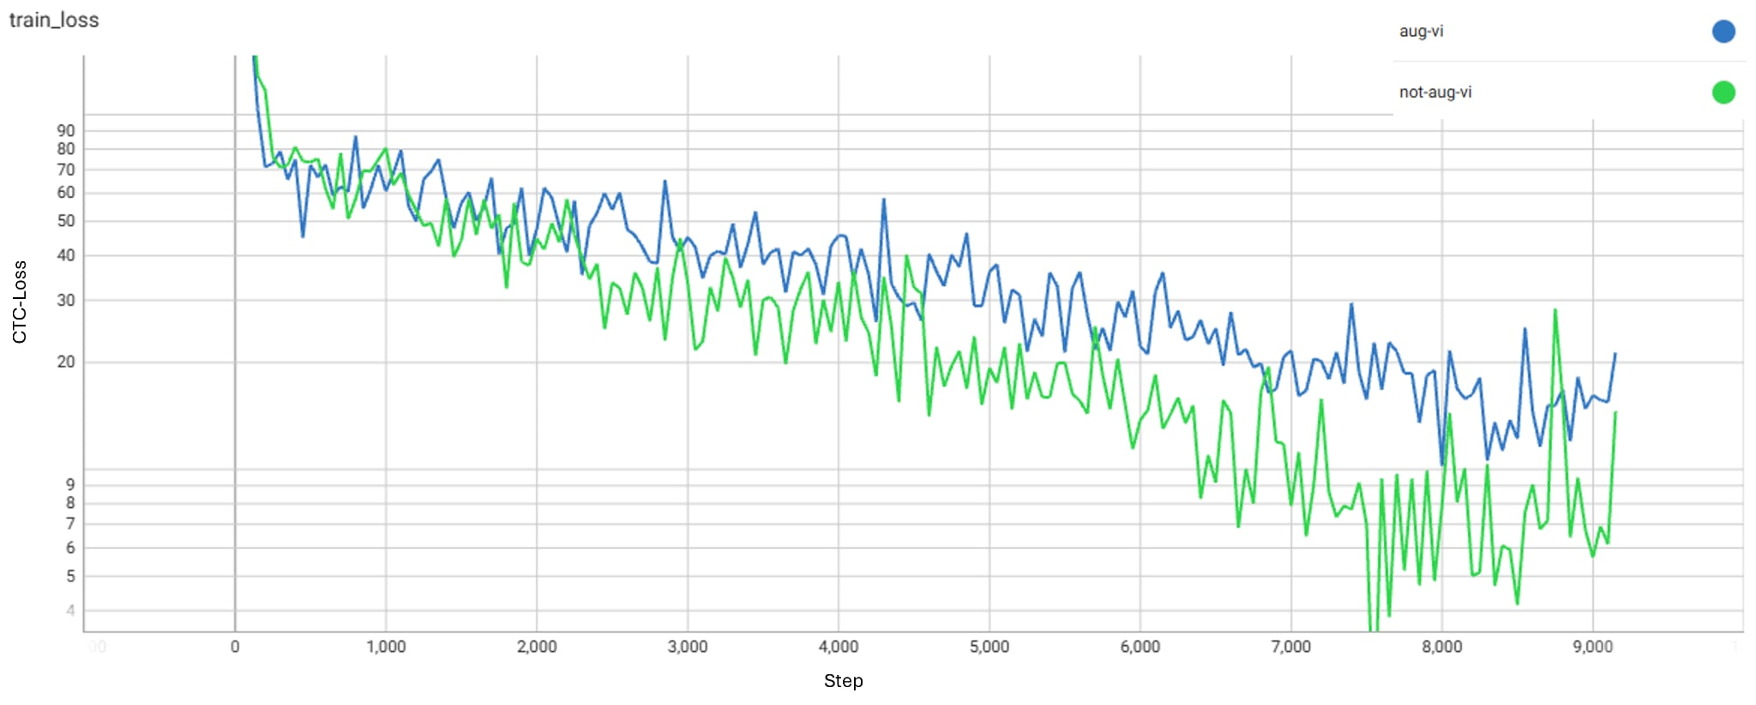
Results and Observations
VIVOS Corpus

Slide 30
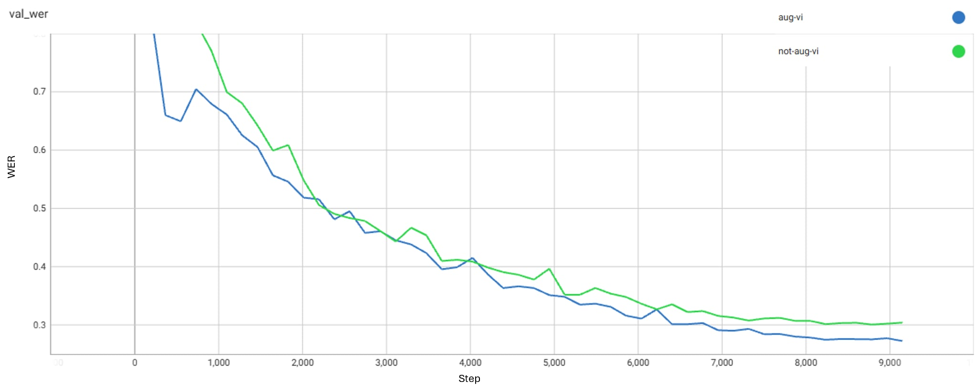
Results and Observations
VIVOS Corpus

Slide 31
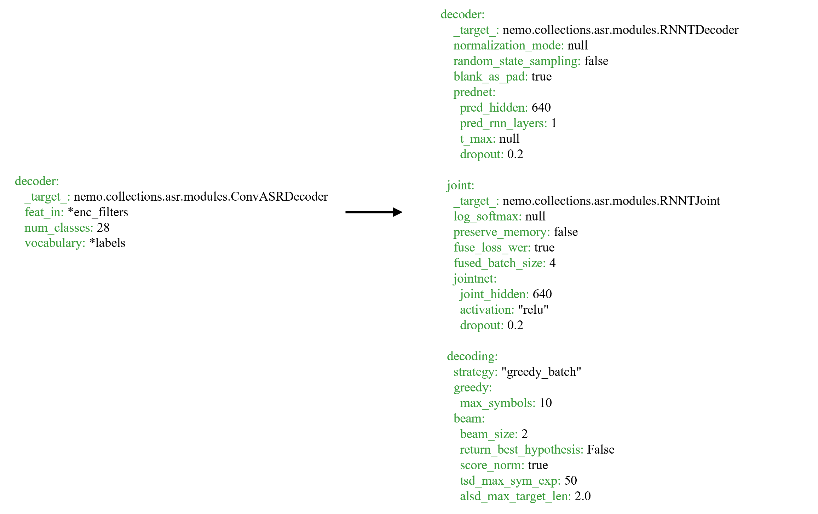
Results and Observations
Thay đổi thành phần decoder (Bên phải: QuartzNet gốc, bên trái: kết hợp với RNN-T)
 | No Fussion |  | With Fussion
 | LibreSpeech-100 | VIVOS | LibreSpeech-100 | VIVOS
QuartzNet | 0.1833 | 0.3006 | - | 0.2739
QuartzNet+SpecAug | 0.1664 | 0.2723 | - | 0.2310

